Slide 1
Machine Learning Model Comparison using scikit-learn
Laura Mas Serra, Kazi Islam, Manuel Domingo Mora
Comparing Supervised Models Across Real World Data Sets
Notes:
In this project, we compare how different machine learning models perform depending on the dataset characteristics.

Slide 2
Project Objective
Apply Supervised Models to 3 Real World Datasets.
Understand how data characteristics affect performance
Identify which models work best and why

Slide 3
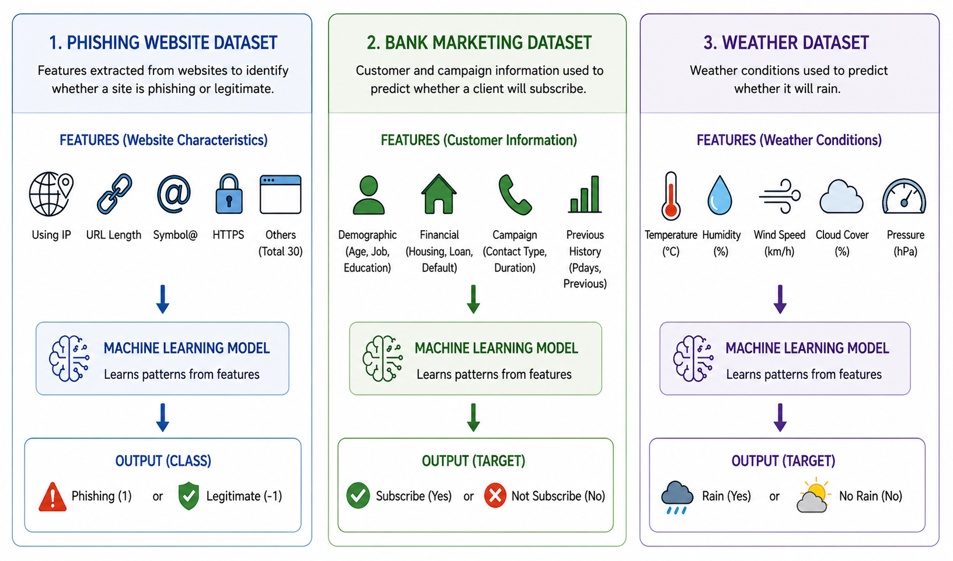
Datasets Used
Phishing Dataset → Detect Fake Websites
Bank Marketing Dataset → Predict Customer Subscription
Weather Dataset → Predict Rainfall
Notes:
We used three datasets representing real-world problems in cybersecurity, business, and weather prediction.
Phishing → “Well-structured, easy classification”
Bank → “Imbalanced dataset (hard problem)”
Weather → “Simple but realistic prediction task”

Slide 4
Data Preparation
Normalized features → improved performance for KNN & Logistic Regression
Train/Test Split (80/20) → Ensured reliable model evaluation
Handled missing values → Prevented Training Errors
Encoded categorical data → converted text to numeric features
Notes:
Before training our models, we cleaned and prepared the data by handling missing values, converting categorical variables into numerical form, scaling the features, and splitting the data into training and testing sets.

Slide 5
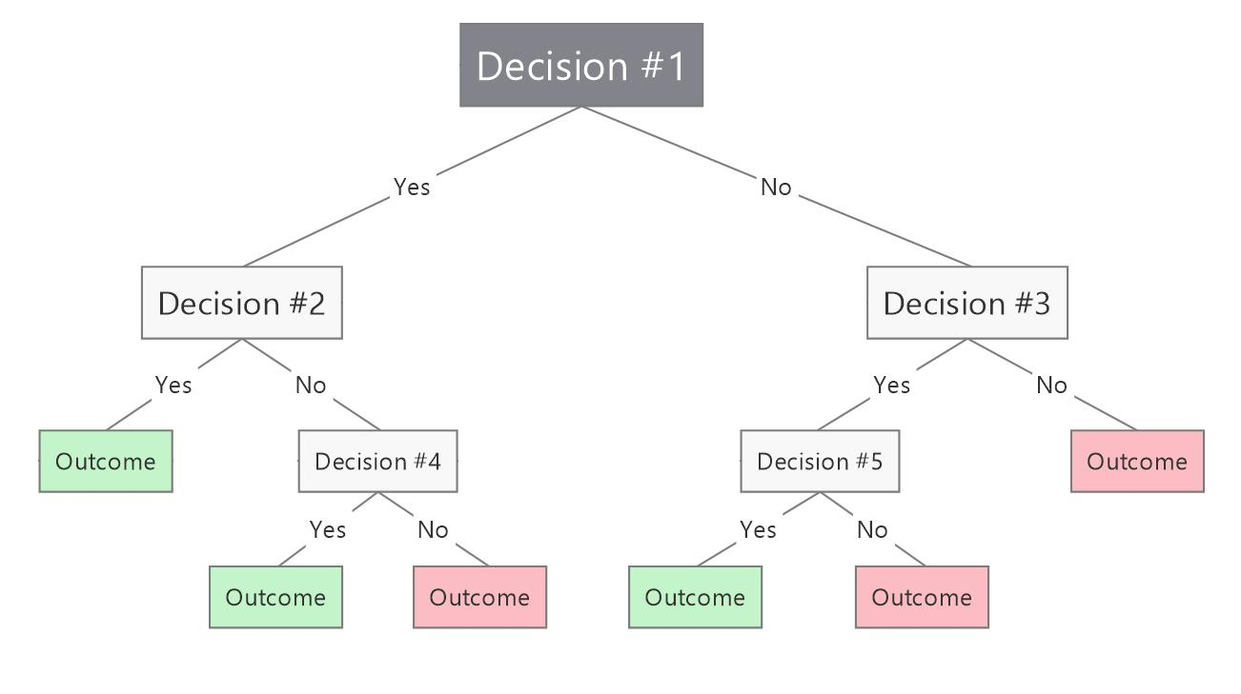
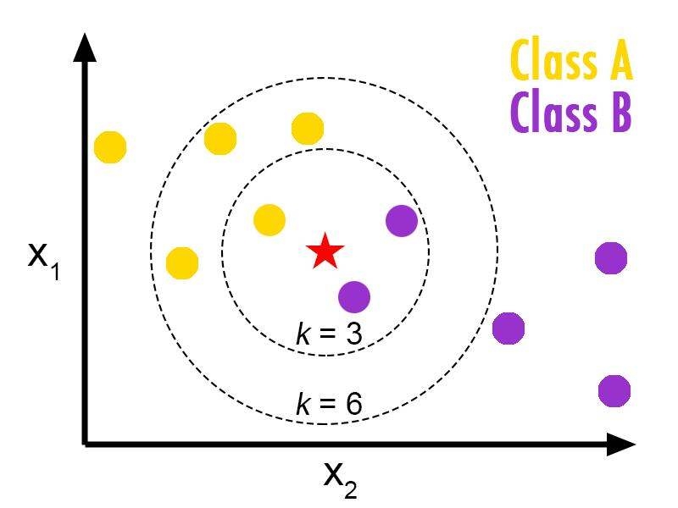
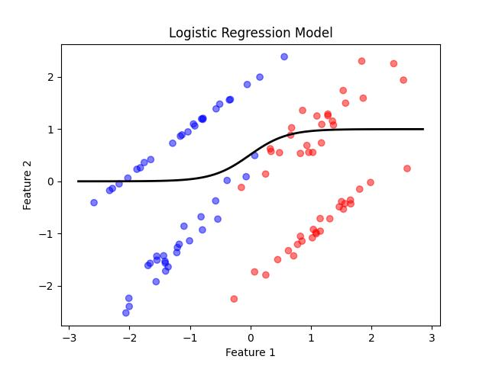
Machine Learning Models
Logistic Regression → Linear Model
Decision Tree → rule-based splits
KNN → distance based
Notes:
We selected three common supervised learning models that work well for classification tasks.

Slide 6
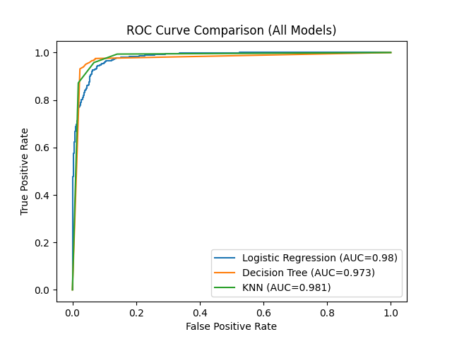
Metrics
Accuracy → Overall Correctness
Precision → Correctness over positive predictions
Recall → ability to detect positives
F1-Score → balance of precision & recall
ROC-AUC → overall separability
Notes:
We used multiple metrics because accuracy alone is not enough, especially for imbalanced datasets. For imbalanced datasets, recall and F1-score are more important than accuracy.

Slide 7
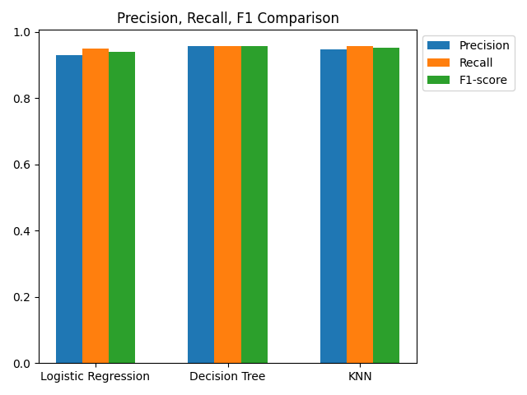
Phishing Results
All models Performed Well (~95% accuracy)
Decision Tree performed the best
Dataset was clean and easy to classify
Notes:
This dataset was well-structured, so all models performed strongly, with Decision Tree slightly outperforming the others Because the dataset is clean and well-structured, all models perform well, especially Decision Tree which captures patterns effectively.

Slide 8
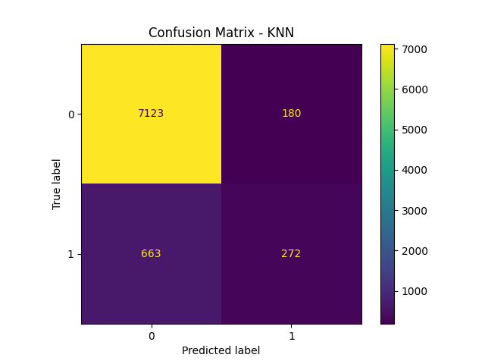
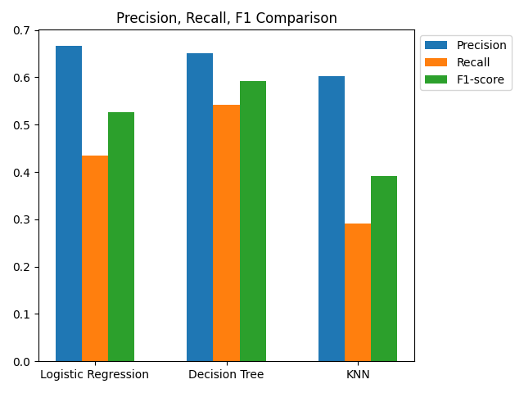
Bank Dataset Results
Dataset was imbalanced
Decision Tree performed the best overall
Logistic Regression missed many positive cases (Low Recall)
KNN performed worse
Notes:
This dataset was more challenging due to class imbalance, which affected model performance significantly.

Slide 9
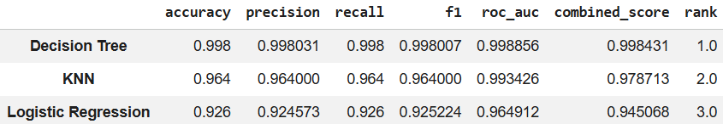
Weather Dataset Results
Decision Tree almost perfect (499/500 Correct)
KNN Performed Well
Logistic Regression struggled with rain cases
Notes:
This dataset was highly separable, allowing the Decision Tree model to achieve near-perfect accuracy.

Slide 10
Model Optimization
Used GridSearchCV
Decision Tree Improved significantly → Reduced Overfitting
Non-Linear Relationships → Decision Tree Advantage
Logistic Regression showed little change → Already well optimized
KNN → Sensitive to parameter changes
Notes:
This project demonstrates how machine learning can be applied effectively, but careful data preparation and evaluation are essential.

Slide 11
Model Comparison
Model
Strengths
Weaknesses
Handles non-linear Patterns
Works well across datasets
Can overfit if too complex
Decision Tree
KNN
Strong on clean, balanced data
No assumptions about data
Struggles with imbalance data
Sensitive to scaling
Logistic Regression
Simple and stable baseline
Fast and interpretable
Limited to linear relationships

Slide 12
Comparison with Prior Work
Our Work
Prior Work
Basic Models
Advanced Models
Train / Test Split
Rolling Validation
Higher AUC
More Realistic Results

Slide 13
Key Takeaways
Imbalanced data is challenging
Accuracy alone is not enough
Decision Tree performed best
Non-Linear Relationships → Decision Tree Advantage
Data quality impact performance
Notes:
Before training our models, we cleaned and prepared the data by handling missing values, converting categorical variables into numerical form, scaling the features, and splitting the data into training and testing sets.

Slide 14
Conclusion
Decision Tree performed the best across all data sets
KNN depends heavily on data quality and balance
Logistic Regression provides a strong baseline
Data preprocessing and evaluation are critical for success
Notes:
This project demonstrates how machine learning can be applied effectively, but careful data preparation and evaluation are essential.

Slide 15
Thank you

